Slide 1

SC1015 Mini Project
World Happiness Index Dataset
Lab Group SC9 Team 9
Cai Kaihang (U2121031J)
Wong Wei Chun (U2122509H)
Notes:
Greetings, we are Kaihang and Wei Chun from Lab group SC9 and this is our SC1015 mini project on the World Happiness Index Dataset which is sourced from Kaggle

Slide 2

World Happiness Index
Can we predict future happiness scores of countries and which model would be the best in doing so?
Notes:
Our problem definition is: Can we predict future happiness scores of countries and which model would be the best in doing so?

Slide 3



Public perceptions
Identify trends early
Notes:
Our practical motivation are as follows:
Factors that have a larger impact on public perception can be identified and this can be useful to many people, such as in allowing businesses to attract potential employees and customers alike by marketing themselves in a particular fashion. For instance, if getting to spend time with family is found to be an important factor in a person’s happiness, then businesses can offer such benefits to potential employees (flexible working hours / work from home), incentivising more to be willing to join, while also painting the company in a positive light in the eyes of the public.
The Predicted happiness scores of countries can be used to identify trends and narrow down the causes of said trends, be it negative or positive in nature, which can benefit the governments in guiding their decision on implementing certain policies.

Slide 4
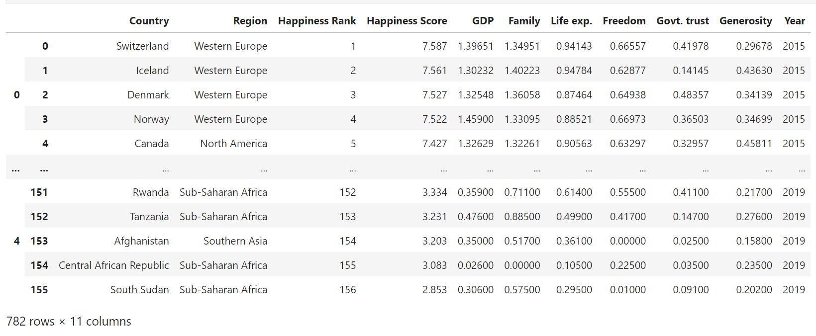
Variables:
Country, Region, Happiness Rank, Happiness Score, GDP, Family, Life Exp., Freedom, Govt. trust, Generosity & Year
Notes:
The variables that we are using are as shown in the slide, and the
Data cleaning process: consists of
Standardization of column names (as different years had different naming conventions)
Addition of ‘Year’ column (because the datasets were to be combined later on, ‘Year’ is needed to still separate them by year for EDA)
Filling of missing data in ‘Region’ based on the other years’ data as well as for one other value that we estimated using the average of the previous years.

Slide 5
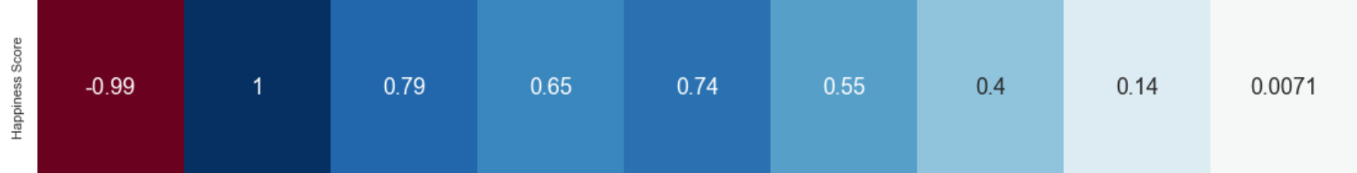
Exploratory Data Analysis
Obvious strong correlation between Happiness Score and Happiness Rank (-0.99)
Fairly strong correlation between Happiness Score and GDP, Life exp., Family, Freedom and Govt. trust
Notes:
Moving on to Exploratory Data Analysis, we started off with a correlation heatmap
Obvious strong correlation to Happiness Rank (-0.99), which is of no surprise to anybody since Happiness rank IS derived from Happiness score and this will NOT be used as part of the data for prediction.
Apart from that, moderately strong correlation between Happiness Score and GDP, Life exp., Family, Freedom and Govt. trust (in descending order).

Slide 6
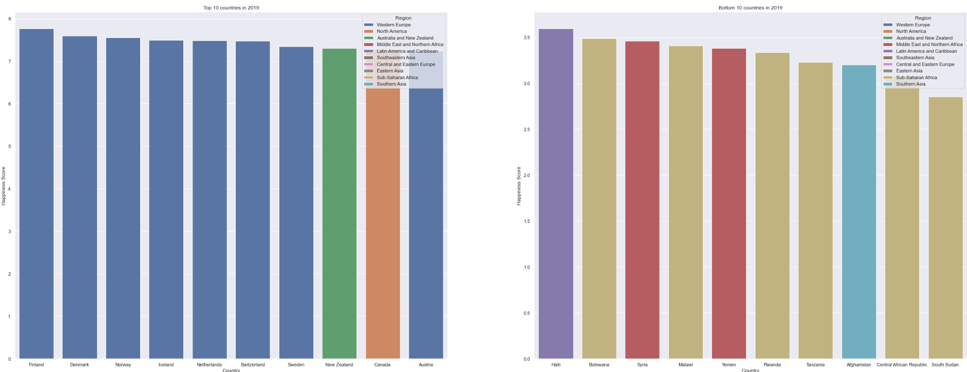
Exploratory Data Analysis
* This is based on 2019 dataset
Notes:
Next, we looked at the top 10 and the bottom 10 countries in terms of happiness score for all the available years, meaning 2015 - 2019. The graph shown on the slide is from the 2019 dataset, but the overall trend still remains, which is that:
Majority of the top 10 happiest countries are from Western Europe, represented on the left in dark blue
Majority of the bottom 10 happiest countries are from Sub-Saharan Africa, represented on the right in light brown

Slide 7
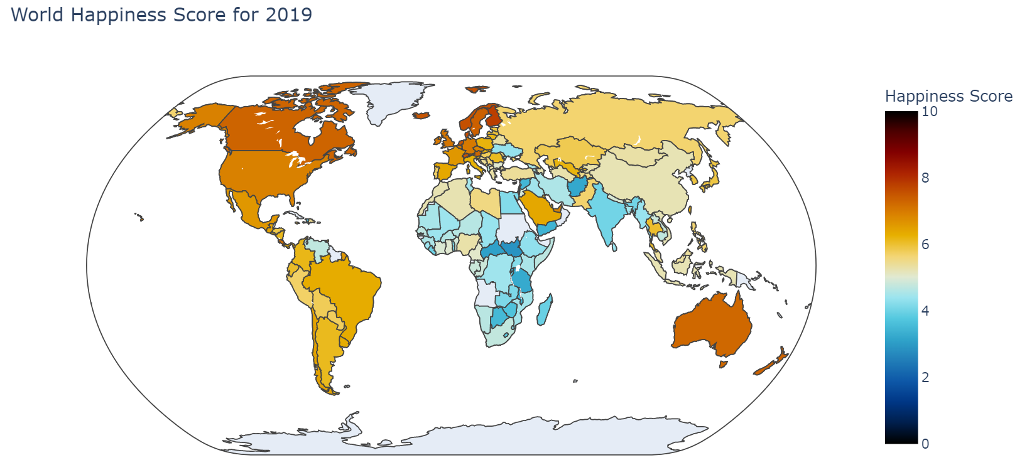
Exploratory Data Analysis
Notes:
Finally, we made a world map visualisation of happiness scores to better identify which countries or regions were the ‘happiest’
From the world map POV based on the 2019 dataset, it is clear that North America and Western Europe have the highest happiness scores. In contrast, the Middle East and Northern Africa seem to have the lowest happiness scores.
In all, it is evident that there is quite a large difference in happiness scores across the world, and a case can certainly be made for countries with lower happiness scores / trend of decreasing happiness scores to realize that such a trend is happening, as well as to have an understanding of the factors that contributed to such a score so as to improve upon them.

Slide 8
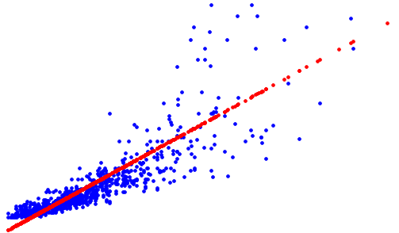
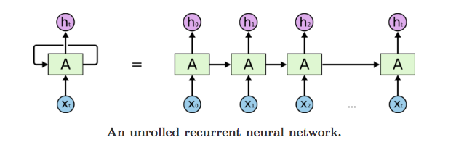
Machine Learning
Regression
Neural Network
Goal: To predict future happiness scores for countries and to find the best model
Multivariate Linear Regression
Recurrent Neural Network (RNN) - Long Short Term Memory (LSTM)
Notes:
Now onto the Machine learning:
In order to predict future happiness scores, we had to use some sort of model that can learn from past data and then predict based off the data, and so we will be using Multivariate linear regression as well as Long Short Term Memory (LSTM)

Slide 9
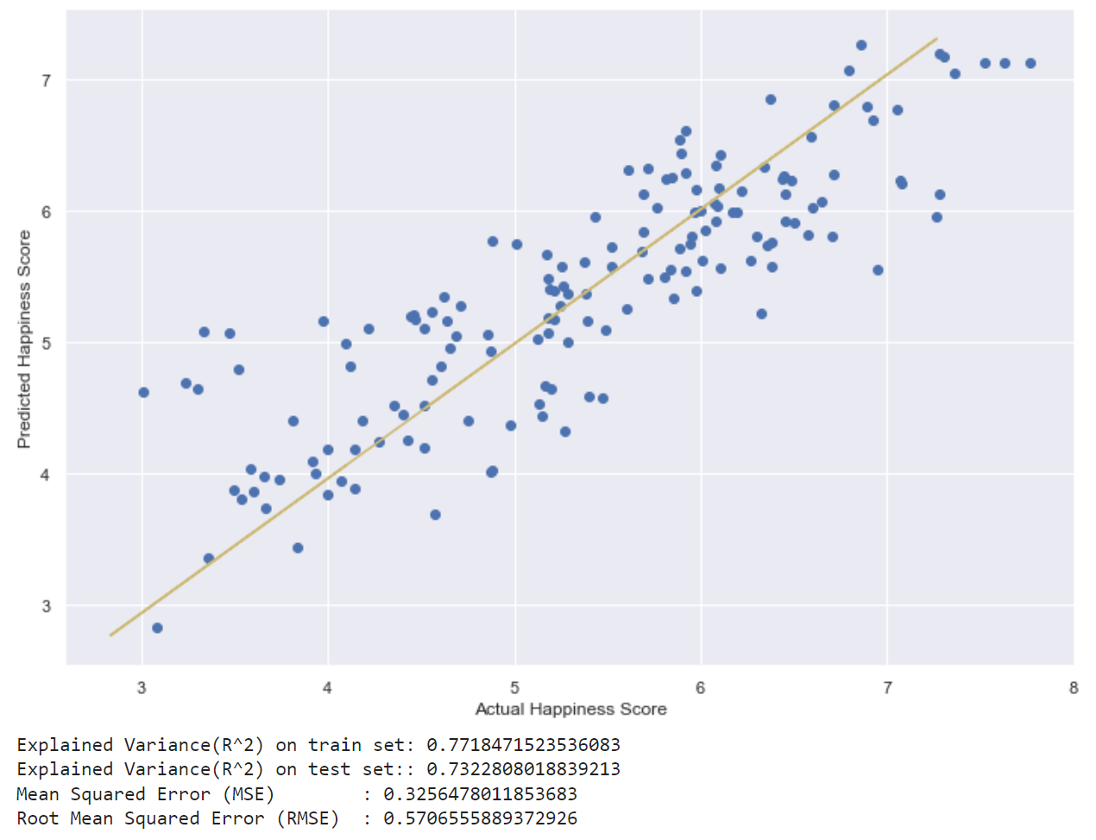
Multivariate Linear Regression
Train and test data split randomly in a ratio of 80:20
Variables used to predict Happiness Score were Country, Region, GDP, Family, Life exp., Freedom, Govt. trust, Generosity
Notes:
(Intro multivariate linear regression)
Multivariate linear regression was used as it could take into account all the factors and then predict future happiness scores based on a best-fit line. The predicted output can then be compared against the actual scores in the dataset to determine its accuracy.
We split the train and test data into a 80:20 ratio, and used Country, Region, GDP, Family, Life exp., Freedom, Govt. trust, Generosity as the variables to predict happiness score.
We will be using Mean Squared Error to judge the accuracy of both models so that a comparison can be made later on. From the image, MSE is about 0.326 rounded to 3 s.f.

Slide 10
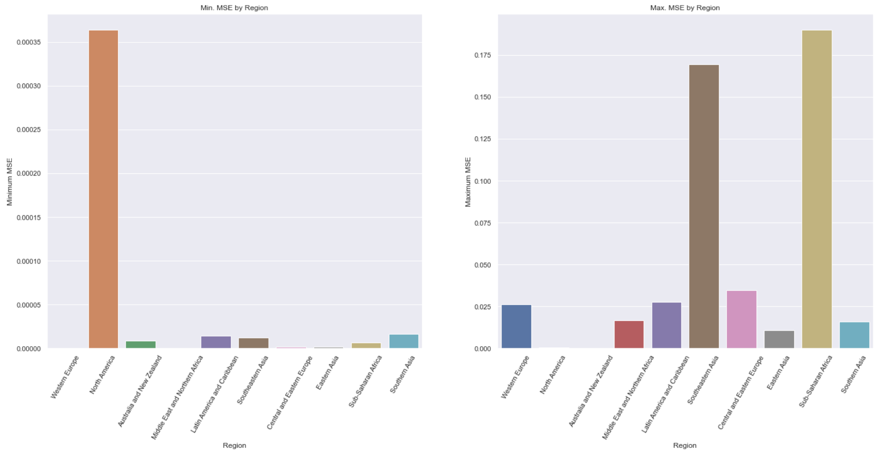
Long Short Term Memory (LSTM)
Notes:
We used a type of Recurrent Neural Network (RNN) called Long Short Term Memory (LSTM), as we can treat the problem as a time-series problem and use the LSTM model to predict future scores based on past ones. Simply put, takes in a bunch of inputs - which are the various factors, processes it and comes up with its predicted response output - which is the happiness score. Each time it does so, the hidden layer of its neural network is also tweaked and improved upon, meaning that past predictions are also ‘considered’ in a sense when computing current and future predictions. The predicted response output can then be compared against the actual scores in the dataset.
In the LSTM implementation, a function was written to have the LSTM model predict the happiness score of a country, compare it against the actual scores to find MSE, and then return it. A separate function was then used to call this particular function for each country in each region and acquire the minimum and maximum MSE found. These functions can be found in the submitted code.
The graph shown describes the minimum MSE by region (left) as well as the maximum MSE by region (right)
Overall very low MSE across all the regions, with Sub-Saharan Africa having the highest Max. MSE of ~0.19, which is still better than the recorded MSE from the multivariate linear regression model
So, we conclude that this model is indeed much better in predicting future happiness scores

Slide 11
What we learnt:
Using another machine learning function:
LSTM to forecast time-series data
Other methods of graphical visualisation:
Choropleth maps using Plotly (to depict the world map data)
Outcome:
Although the predicted values from the LSTM model were certainly very accurate based on the given dataset it could train on, there is an argument for happiness scores not being all that predictable in the first place because of how volatile the idea of happiness can be.
But, there are still some uses for the results from this model!
Notes:
From this mini project, we have learnt about a new machine learning function in LSTM for prediction time-series data, as well as another method of graphical visualisation in choropleth maps using plotly.
The outcome is that:
While prediction from RNN was very accurate - much more so than the multivariate linear regression model (based on MSE), it should be said that happiness scores can be influenced by the other factors that were not provided in the dataset such as the time of data recording, as happiness scores would likely differ during a holiday season compared to during times of stress such as the exam period for students.
Since the predicted values are based on general trends, it can only serve as a projection of happiness scores assuming that nothing changes, which is unrealistic, but can be considered to be the ideal value for countries to strive towards, i.e. as a ‘goal’ of sorts

Slide 12
Data-driven insights
To improve on both models, a larger dataset would certainly be beneficial
GDP has the highest correlation to happiness scores based on the entire dataset (correlation coefficient of 0.79)
Perhaps money does buy happiness after all?
Overall trend of increasing happiness scores for countries that are on the lower end
Notes:
Some of our data-driven insights include:
To further improve, more can certainly be done to increase the datasets to include other years so as to improve the RNN model.
GDP has the highest correlation to happiness scores based on the entire dataset - perhaps money does buy happiness, or is at least a catalyst for happiness.
There is an trend of increasing happiness scores for countries that were on the lower end of it, especially for those in the Middle Eastern region.
And with that, we have come to the end of our presentation, thank you for listening!

Slide 13
Contributions
Kaihang - Data Cleaning, EDA, Data Visualisation, Regression, LSTM, Slides
Wei Chun - Regression

Slide 14
References:
World happiness dataset: https://www.kaggle.com/datasets/unsdsn/world-happiness
Plotly: https://plotly.com/python/choropleth-maps/
Plotly: https://plotly.github.io/plotly.py-docs/generated/plotly.express.choropleth.html
LSTM:
https://towardsdatascience.com/lstm-framework-for-univariate-time-series-prediction-d9e7252699e
Intro to RNN & LSTM: https://www.youtube.com/watch?v=Mdp5pAKNNW4
Time Series Forecasting using LSTM: https://www.youtube.com/watch?v=S8tpSG6Q2H0

